Slide 1

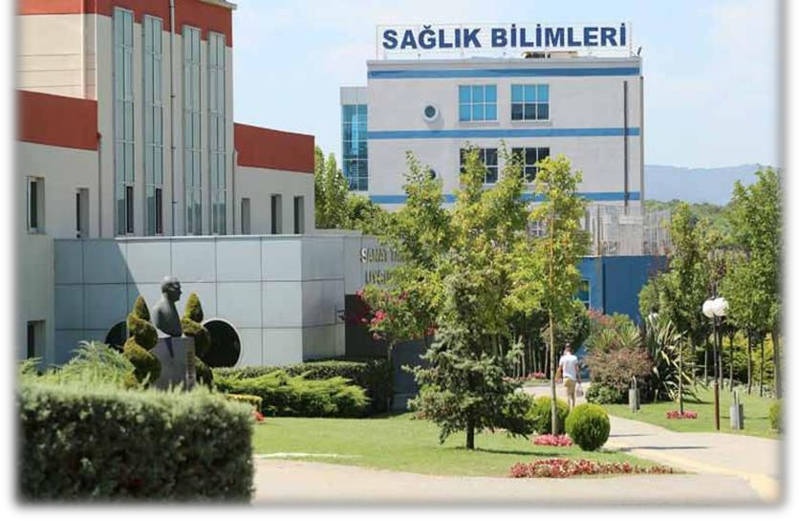
FACULTY OF HEALTH SCIENCES
DEPARTMENT OF NURSING
2026 – 2027 Orientation Booklet

Slide 2
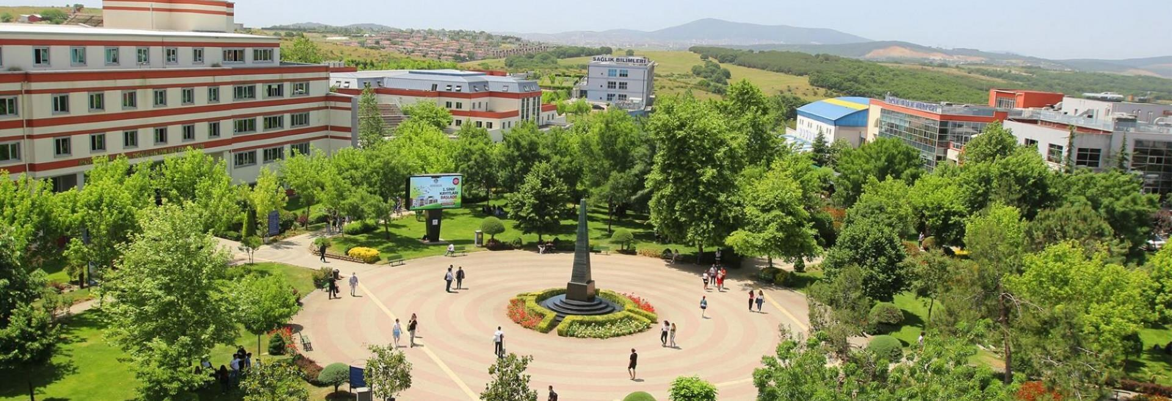
Istanbul Okan University
Tuzla Campus
Address: Tuzla Campus, 34959 Akfırat – Tuzla / ISTANBUL, TÜRKİYE
Phone: +90 (216) 677 16 30 · 444 OKAN (6526) · okan@okan.edu.tr

Slide 3

The Nursing Profession and Our Department
In today's healthcare system, the need for nurses is steadily increasing at both national and international levels. Nurses are indispensable members of the healthcare team in protecting and promoting the health of individuals, families and communities, and in restoring health in times of illness.
Our department aims to educate qualified nurses who are aware of their professional, ethical and legal responsibilities, who can think critically and solve problems, who work well in interdisciplinary teams, and who deliver high-quality, evidence-based care.
Undergraduate Nursing programs are offered at many universities in Türkiye under the Council of Higher Education (YÖK). The most up-to-date information about our program is available on YÖK Atlas:
➢ yokatlas.yok.gov.tr/lisans.php?y=204713056
Istanbul Okan University · Faculty of Health Sciences · Department of Nursing
3

Slide 4
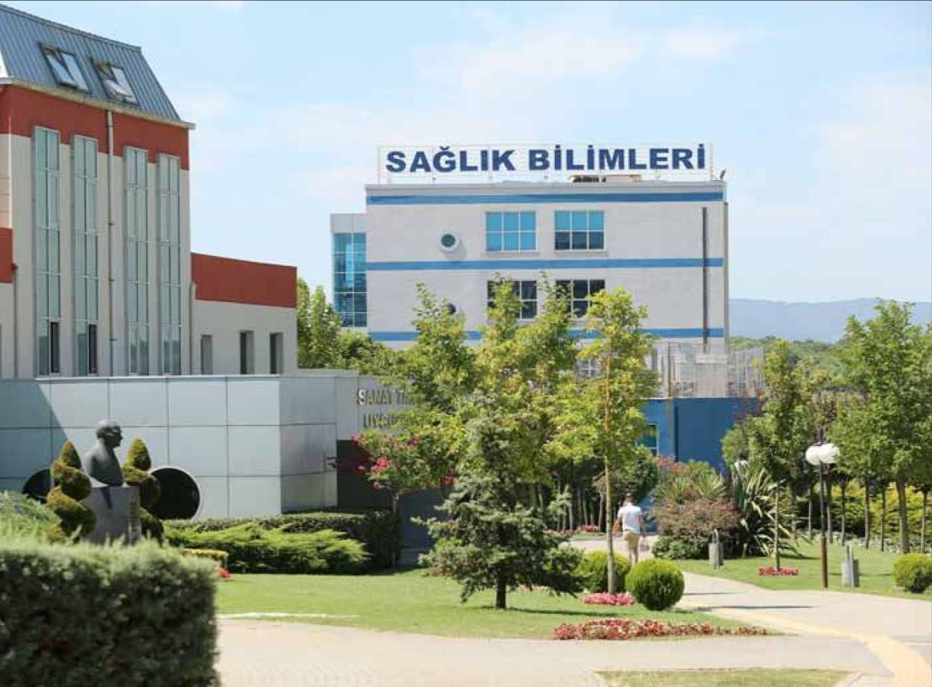
Istanbul Okan University, Faculty of Health Sciences, Department of Nursing
has been providing education grounded in the scientific and ethical foundations of the nursing profession since 2009.
The program lasts 4 years (8 semesters) and consists of a total of 246 ECTS credits.
Students are admitted to our department with the YKS–SAY (numerical) score type.
Master's and doctoral programs in Nursing are also offered within the Institute of Graduate Studies.
Istanbul Okan University · Faculty of Health Sciences · Department of Nursing
4

Slide 5
Program Objective
To educate nurses who plan, organize, implement and evaluate nursing services aimed at protecting and promoting the health of individuals, families and communities and restoring health in illness; who train those who will deliver these services; who can serve as researchers, counselors and managers; and who can work in interdisciplinary teams.
Our education follows a holistic approach through theory, skills laboratory practice, clinical practice and internships.
Istanbul Okan University · Faculty of Health Sciences · Department of Nursing
5

Slide 6
Program Outcomes
Our graduates…
1
Plan, implement and evaluate nursing care in accordance with ethical principles and legal regulations.
6
Contribute to the development of health policies by sharing their views.
2
Analyze theoretical knowledge in clinical practice and translate it into appropriate nursing interventions.
7
Take an active role and responsibility in nursing practice, both individually and as team members.
3
Perform core nursing psychomotor skills correctly and safely in clinical settings.
8
Use appropriate health informatics systems effectively in the care process.
4
Communicate effectively, verbally and in writing, with individuals, families, team members and other stakeholders.
9
Explain the current social and cultural knowledge required for contemporary nursing practice.
5
Assess the health needs of individuals, families and communities and fulfil the appropriate nursing roles and functions.
10
Take part in community-based projects and activities in collaboration with other disciplines.
Istanbul Okan University · Faculty of Health Sciences · Department of Nursing
6

Slide 7
A nurse
is a professional who has completed undergraduate nursing education and holds a diploma; who identifies the health needs of individuals, families and communities; who plans, implements and evaluates care based on nursing diagnoses; who carries out the diagnostic and treatment procedures planned by the physician; and who provides health education and counseling.
The duties, authority and responsibilities of our profession are defined by the following legislation:
▪ Nursing Law No. 6283
https://www.mevzuat.gov.tr/mevzuatmetin/1.3.6283.pdf
▪ Nursing Regulation (Official Gazette, 08.03.2010 / 27515)
https://www.resmigazete.gov.tr/eskiler/2010/03/20100308-4.htm
▪ Regulation on the Job and Duty Descriptions of Health Professionals and Other Professionals Working in Health Services (Official Gazette, 22.05.2014 / 29007)
https://www.resmigazete.gov.tr/eskiler/2014/05/20140522-14.htm
Istanbul Okan University · Faculty of Health Sciences · Department of Nursing
7

Slide 8
Duties, Authority and Responsibilities of the Nurse
In summary, under the relevant legislation, the nurse:
✓ Identifies the health needs of individuals, families and communities through data collection and makes nursing diagnoses.
✓ Plans, implements, evaluates and documents evidence-based nursing care.
✓ Safely carries out diagnostic and treatment procedures planned by the physician.
✓ Ensures patient safety and infection control, and provides first response in emergencies.
✓ Provides health education and counseling to individuals, families and communities.
✓ Respects patient rights, privacy and professional ethics, and acts as the patient's advocate.
✓ Takes part in the management of nursing services, quality improvement and research.
✓ Collaborates with other members of the healthcare team and pursues lifelong professional development.
Istanbul Okan University · Faculty of Health Sciences · Department of Nursing
8

Slide 9
Our Curriculum
4 years · 8 semesters · 159 credits · 246 ECTS
Theoretical Education
Skills Laboratory
Clinical Practice
Summer Internships
Internship Program
Delivered face-to-face and interactively in classrooms.
Practice with manikins and scenarios in the Simulation Center Nursing Laboratory.
In-semester practice in hospitals and the field for core nursing courses.
Mandatory summer internships at the end of the 2nd, 4th and 6th semesters.
Comprehensive clinical practice in the 8th semester that prepares the transition into the profession.
First-year students may not perform on patients any procedure they have not first practised on a manikin in the laboratory; laboratory work is therefore a prerequisite for clinical practice.
Istanbul Okan University · Faculty of Health Sciences · Department of Nursing
9

Slide 10
IN-SEMESTER CLINICAL PRACTICE
The current curriculum and course descriptions are available on the department website.
Semester | 1st Year | 2nd Year | 3rd Year | 4th Year
Fall Semester | None | Internal Medicine Nursing | Obstetrics and Gynecology Nursing | -Public Health Nursing -Nursing Services Management
Spring Semester | Fundamentals of Nursing | Surgical Nursing | -Pediatric Nursing -Psychiatric and Mental Health Nursing | Internship
Curriculum: okan.edu.tr/sbf/sayfa/2574/ders-plani Course Descriptions: okan.edu.tr/sbf/sayfa/377/ders-icerikleri
Istanbul Okan University · Faculty of Health Sciences · Department of Nursing
10

Slide 11
Sample Departmental Elective Courses
Options to develop yourself according to your interests
✓ Transcultural Nursing
✓ Working with Individuals with Disabilities
✓ Sign Language
✓ Sexual Health / Reproductive Health
✓ Health Assessment and Physical Examination I–II
✓ Nursing Process Workshop
✓ Patient Safety Practices
✓ Operating Room Nursing
✓ Forensic Nursing
✓ Home Care Nursing
✓ Geriatric Nursing
✓ Nursing and the Leadership Process
✓ Psychosocial Problems and Nursing
✓ Critical Thinking Practices
✓ Critical Care Practices
✓ Nursing Informatics
✓ Health Promotion
✓ Health Tourism and Nursing
✓ Medical Ethics and Patient Rights
✓ Quality Management in Health Services
✓ Evidence-Based Practice in Health Sciences
Istanbul Okan University · Faculty of Health Sciences · Department of Nursing
11

Slide 12
Our Education
consists of theoretical and practical components. Theoretical education is delivered face-to-face and interactively in classrooms.
Practical education takes place in the Simulation Center Nursing Laboratory, at Istanbul Okan University Hospital and in public, foundation and private healthcare institutions designated by the Internship Committee.
For summer internships, students may apply by following the periods announced on Kariyer Kapısı (Career Gateway), or arrange their own internship placement with the approval of the Head of Department.
The schedule for in-semester clinical practice is announced to students at the start of each semester; assigned faculty members supervise students in the clinic.
Istanbul Okan University · Faculty of Health Sciences · Department of Nursing
12

Slide 13
Simulation Center
700 m² area · 8 practice stations
Medical (Basic) Skills Laboratory
Nursing Room
Emergency Department
Delivery Room
Intensive Care
Operating Room
Outpatient Clinics
✓ Students experience situations they will face in the clinic in a safe environment, using manikins and scenarios.
✓ Basic and advanced nursing skills are reinforced through repetition in the laboratory before bedside practice.
✓ Post-simulation debriefing integrates theoretical knowledge with clinical reasoning.
Istanbul Okan University · Faculty of Health Sciences · Department of Nursing
13

Slide 14
Our Practice Settings
✓ Istanbul Okan University Hospital
✓ Public hospitals and training and research hospitals
✓ University hospitals
✓ Private hospitals (at least 100 beds for summer internships)
✓ Outpatient and inpatient health centers
✓ Family health centers
✓ Nursing homes and elderly care centers
✓ Care and rehabilitation centers
✓ Schools (school health)
✓ Workplaces (occupational health)
✓ Non-governmental organizations
✓ Municipal centers (e.g. Tuzla Municipality Senior Center)
Istanbul Okan University · Faculty of Health Sciences · Department of Nursing
14

Slide 15
In-Semester Clinical Practice
From the Nursing Department Directive on In-Semester Practice and Summer Internships
80%
08.00
16.00
60 min
attendance required
in the clinic, in uniform
end of practice
Meal and breakfast break
✓ Students must attend at least 10 working days of practice; those who do not meet the attendance requirement fail the course.
✓ Students who arrive after 08:30 or leave before the end time are marked absent for that day.
✓ In-semester practice takes place at institutions in Istanbul; there is no practice on public holidays.
✓ Students may not perform invasive procedures without a nurse's supervision; patient handover is done at the start and end of each day.
✓ Assessment is by written/oral exams, bedside evaluation, skills exams, care plans and similar methods.
Istanbul Okan University · Faculty of Health Sciences · Department of Nursing
15

Slide 16
Mandatory Summer Internships
Semester | Internship | Duration
End of 2nd semester | Fundamentals of Nursing | 20 working days (4 weeks)
End of 4th semester | Internal Medicine Nursing | 15 working days (3 weeks)
End of 4th semester | Surgical Nursing | 15 working days (3 weeks)
End of 6th semester | Obstetrics and Gynecology Nursing | 15 working days (3 weeks)
End of 6th semester | Pediatric Nursing | 15 working days (3 weeks)
✓ Prerequisite: Passing the related course during the semester. Students who have not completed the 1st-year internship cannot proceed to upper-year internships.
✓ Attendance: 100% attendance is required for summer internships (1 working day = 8 hours).
✓ Location: University / Ministry training and research hospitals, or private healthcare institutions with at least 100 beds.
✓ Application: At least 45 days before the internship starts; the Mandatory Internship Application Form must be approved by the Head of Department.
✓ Report: At least one care plan per week (minimum 2 in total) is prepared and submitted during course registration week.
Summer internships may also be completed outside Istanbul and, with the approval of the Head of Department, abroad (Erasmus+ / Exchange or independently).
Istanbul Okan University · Faculty of Health Sciences · Department of Nursing
16

Slide 17
Internship File and Internship Insurance
Documents required to obtain the internship file
✓ Internship acceptance letter from the healthcare institution
✓ Copy of student ID card
✓ Copy of national ID card / passport (2 copies)
✓ Criminal record certificate from the public prosecutor's office
✓ Any other documents requested by the host institution
Contents of the Mandatory Internship File
✓ Mandatory Internship Application Form (approved)
✓ Insurance Commencement Declaration
✓ Student Internship Attendance Sheet
✓ Clinical Practice Evaluation Form
✓ Care Plan / Course-Specific Report File
Important: Documents required for insurance must be submitted to the Head of Department 15 days before the first practice/internship date. Insurance premiums are paid by the University.
Istanbul Okan University · Faculty of Health Sciences · Department of Nursing
17

Slide 18
Internship Program (8th Semester)
Aims for students to master the cognitive, affective and psychomotor skills gained in previous years and to orient them to the profession.
Objectives
✓ Competence in nursing skills across different clinical settings
✓ Developing clinical decision-making and communication skills
✓ Nursing process, critical thinking and problem solving in care management
Prerequisite: Successful completion of all core nursing courses. Students must attend at least 36 working days of practice.
Assessment Component | Weight
Overall Performance (attitude and attendance) | 25%
Care Plan Assessment | 50%
Theoretical Knowledge Assessments | 15%
Clinical Assessment | 10%
Practice settings: internal medicine and surgical inpatient wards, intensive care units, operating rooms and emergency departments. Students hold a case discussion with a faculty member at least once a week.
Istanbul Okan University · Faculty of Health Sciences · Department of Nursing
18

Slide 19
Uniform and Clinical Conduct Rules
Appearance
✓ The Okan-emblem nursing uniform is worn only in the practice area; it must be clean and ironed, with the student ID displayed.
✓ Hair is tied back; nails are short and unpolished (or clear polish). No jewellery except a watch with a second hand and small earrings.
✓ Closed white/navy/black shoes; white or skin-coloured socks. A white/navy zip-up fleece may be worn in cold weather.
✓ Carry a small notebook and pen in your pocket.
Ethics and Privacy
✓ Mobile phones are kept on silent and used only when necessary.
✓ No photos, video or audio recordings without permission, and no sharing on social media.
✓ Patient confidentiality is protected; students must comply with the Personal Data Protection Law (KVKK).
✓ No smoking in or around the hospital.
✓ Communicate respectfully and ethically with the healthcare team, patients and their relatives.
Istanbul Okan University · Faculty of Health Sciences · Department of Nursing
19

Slide 20
In Case of an Occupational Accident (Needlestick, Injury, etc.)
1
2
3
4
Report
Record
Submit
SGK
Contact your advisor immediately and inform the education unit of your host institution.
Make sure the incident report and notification forms are completed at the host institution.
Send the notification form to your advisor and Okan Human Resources by email or in person.
The University must report the accident to the Social Security Institution (SGK) within 3 working days.
Any problem that arises during practice or internship must be reported to the relevant faculty member without delay.
Istanbul Okan University · Faculty of Health Sciences · Department of Nursing
20

Slide 21
Our graduates can work
✓ in public and private hospitals,
✓ in outpatient diagnosis and treatment facilities,
✓ in health education and counseling institutions,
✓ in school health and occupational health,
✓ in elderly health and home care services,
✓ in health insurance institutions,
✓ in environmental and tourism health,
✓ in forensic medicine services,
✓ and in the pharmaceutical industry.
✓ They can also pursue an academic career through master's and doctoral studies.
Istanbul Okan University · Faculty of Health Sciences · Department of Nursing
21

Slide 22

Department of Nursing Academic Staff, 2026 – 2027 Academic Year
Asst. Prof. Dr. Ceren AYCANOĞLU (Head of Department)
Prof. Dr. Sebahat ATEŞ
Asst. Prof. Dr. Ayşe Dudu KILINÇ
Asst. Prof. Dr. Deniz ACUNER
Asst. Prof. Dr. Özlem AKGÖL
Asst. Prof. Dr. Özlem YAZICI
Asst. Prof. Dr. Raife AŞIK
Lecturer Güner Ekin DEMİRTAŞ UÇKIRAN
Res. Asst. Hiranur SARIYILDIZ
Res. Asst. Nurşah SAPA

Slide 23
Our Academic Advisors
Each student is assigned an academic advisor according to their year.
Year | TR Group | ENG Group
1st Year | Asst. Prof. Dr. Raife Aşık | Asst. Prof. Dr. Ceren Aycanoğlu
2nd Year | Asst. Prof. Dr. Özlem Akgöl | Asst. Prof. Dr. Deniz Acuner
3rd Year | Lecturer Güner Ekin Demirtaş Uçkıran | Asst. Prof. Dr. Deniz Acuner
4th Year | Asst. Prof. Dr. Ayşe Dudu Kılınç | Asst. Prof. Dr. Özlem Yazıcı
Your advisor is your first point of contact for course registration, internships, and academic and personal matters. Advisor office hours are posted on the department website and in OBS (Student Information System).
Istanbul Okan University · Faculty of Health Sciences · Department of Nursing
23

Slide 24
Our Department and the Nursing Club
Seminars, symposia, fieldwork and social responsibility projects are organized in collaboration with the “Nursing Club” founded by our students.
These activities offer valuable opportunities to strengthen professional solidarity, meet experts in the field and contribute to community health.
Email: toplulukhemsirelik@stu.okan.edu.tr
Events: okan.edu.tr/sbf – Nursing › Events
Sample events from 2025
✓ 11th Lamp Lighting Ceremony
✓ Visit to the Florence Nightingale Museum (Selimiye Barracks)
✓ Infertility Nursing Symposium
✓ Childhood Leukemias and the Role of the Nurse
✓ Obesity Awareness and Prevention Strategies
✓ The Cycle of Substance Addiction: From Onset to Treatment
✓ Visit to the Tuzla Municipality Senior Center
Istanbul Okan University · Faculty of Health Sciences · Department of Nursing
24

Slide 25
Our Dean of Students Office
offers Happy Life courses such as volleyball, swimming, fitness and ballroom dancing, helping our students grow in sports and social life and enrich their campus experience.
Every student can meet with their assigned advisor to get support on any matter they need.
Istanbul Okan University · Faculty of Health Sciences · Department of Nursing
25

Slide 26
Every effort is made to educate qualified nurses at national and international levels, and to help our valued students feel that they are members of the Istanbul Okan University family.
Our students receive the support they need to graduate with the best education from Istanbul Okan University, “the university closest to working life”, and to step confidently into their careers as “Nurses”.
Starting a professional career as a graduate of the Istanbul Okan University Faculty of Health Sciences, Department of Nursing, is a privilege.
Istanbul Okan University · Faculty of Health Sciences · Department of Nursing
26

Slide 27
Useful Links
➢ Nursing Department homepage: okan.edu.tr/sbf/bolum/52/hemsirelik/
➢ Program Objectives and Outcomes: okan.edu.tr/sbf/sayfa/9591/program-amaclari-ve-kazanimlari/
➢ Curriculum: okan.edu.tr/sbf/sayfa/2574/ders-plani/
➢ Course Descriptions: okan.edu.tr/sbf/sayfa/377/ders-icerikleri/
➢ Internship Information (Directive and Internship File): okan.edu.tr/sbf/sayfa/379/staj-yonergesi/
➢ Academic Staff: okan.edu.tr/sbf/sayfa/376/akademik-kadro/
➢ Department Advisors: okan.edu.tr/sbf/sayfa/8912/hemsirelik-bolumu-danismanliklari/
➢ Faculty Student Application Forms: okan.edu.tr/sbf/sayfa/5552/ogrenci-basvuru-formlari-sbf/
Istanbul Okan University · Faculty of Health Sciences · Department of Nursing
27

Slide 28
Dear Students,
We are honoured and delighted
to welcome you among us
for the new academic year.
WELCOME TO THE ISTANBUL OKAN UNIVERSITY FAMILY!
We are glad to have you with us.
We wish you every success.
With warm regards…
Istanbul Okan University · Faculty of Health Sciences · Department of Nursing
28

