Slide 1
Istanbul Okan University
Faculty of Business and Administrative Sciences
Researchers Catalog
2024-2025

Slide 2
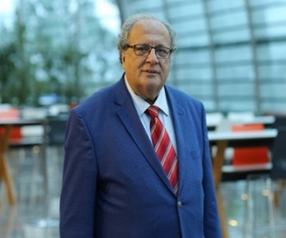
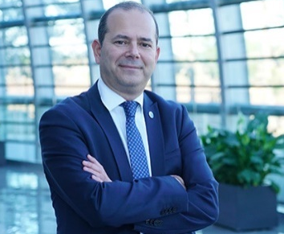
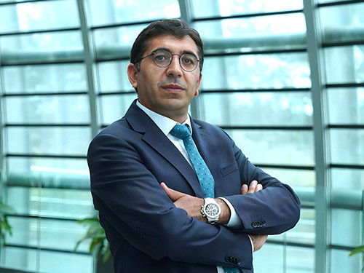
Bülent Günceler
Assoc. Prof.
Ceyda Ovacı
Assoc. Prof.
TITLE
TITLE
PHD
Marmara University
PHD
Anadolu University
RESEARCH AREA
Banking
RESEARCH AREA
Entrepreneurship and Marketing, Social Marketing and Sustainability, Consumer Behavior
E-MAIL
bulent.gunceler@okan.edu.tr
E-MAIL
ceyda.ovacı@okan.edu.tr
PHONE
0 (216) 677 16 30 #2534
PHONE
0 (216) 677 16 30 #2548
Business Administration
Edin Güçlü Sözer
Assoc. Prof.
Turgay Münyas
Assoc. Prof.
TITLE
TITLE
PHD
Yeditepe University
PHD
Istanbul Okan University
RESEARCH AREA
Marketing Communication, Product and Brand Management, Consumer Behavior
RESEARCH AREA
Financial Markets and Institutions, International Finance, Financial Forecasting and Modeling
E-MAIL
edin.sozer@okan.edu.tr
E-MAIL
turgay.munyas@okan.edu.tr
PHONE
0 (216) 677 16 30 #1330
PHONE
0 (216) 677 16 30 #2582

Slide 3
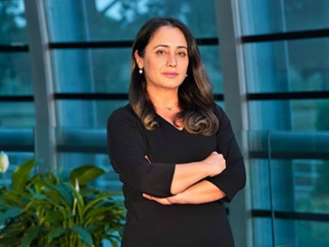
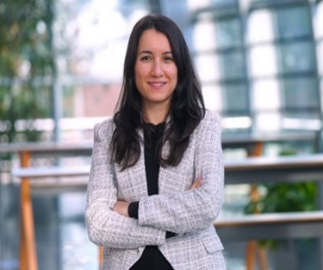
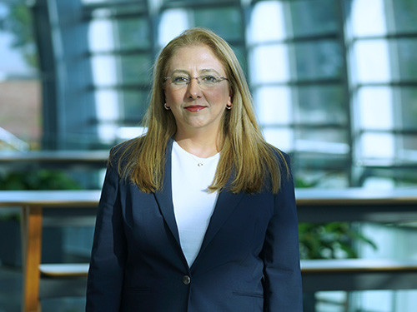
Beynaz Uysal
Asst. Prof.
Canan Koçer Durmaz
Asst. Prof.
TITLE
TITLE
PHD
Istanbul University
PHD
Tekirdağ Namık Kemal University
RESEARCH AREA
Human Resource Management, Organizational Behavior, Organization
RESEARCH AREA
Organizational Behavior, Management and Organization, Mindfulness
E-MAIL
beynaz.uysal@okan.edu.tr
E-MAIL
canan.kocer@okan.edu.tr
PHONE
0 (216) 677 16 30 #2586
PHONE
0 (216) 677 16 30 #2613
Business Administration
Deniz Sönmez
Asst. Prof.
Emine Başak Tavman
Asst. Prof.
TITLE
TITLE
PHD
Istanbul Gelisim University
PHD
Marmara University
RESEARCH AREA
Strategic Management, Health Service Management,, Human Resource Management
RESEARCH AREA
Marketing, Consumer Behavior
E-MAIL
deniz.sonmez@okan.edu.tr
E-MAIL
basak.tavman@okan.edu.tr
PHONE
0 (216) 677 16 30
PHONE
0 (216) 677 16 30 #2613

Slide 4
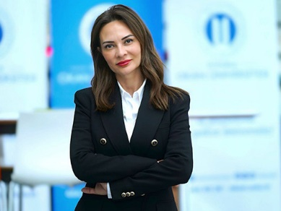
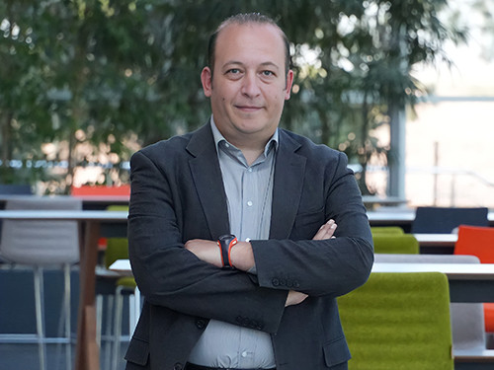
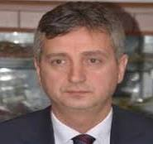
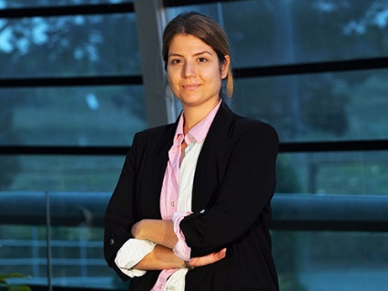
Fatih Koç
Asst. Prof.
Ercan Özgül
Asst. Prof.
TITLE
TITLE
PHD
Istanbul Okan University
PHD
RESEARCH AREA
Accounting, Auditing
RESEARCH AREA
Management and Organization
E-MAIL
fatih.koc@okan.edu.tr
E-MAIL
ercan.ozgul@okanhastanesi.com.tr
PHONE
0 (216) 677 16 30 / 2401
PHONE
0 (216) 677 16 30
Business Administration
Fatma Sebla Uzuntepe
Asst. Prof.
Fitnat Nazlı Yağız
Asst. Prof.
TITLE
TITLE
PHD
Istanbul Okan University
PHD
Marmara University
RESEARCH AREA
Entrepreneurship
RESEARCH AREA
Organizational Behavior
E-MAIL
sebla.uzuntepe@okan.edu.tr
E-MAIL
nazli.yagiz@okan.edu.tr
PHONE
0 (216) 677 16 30 #2454
PHONE
0 (216) 677 16 30 #2572

Slide 5
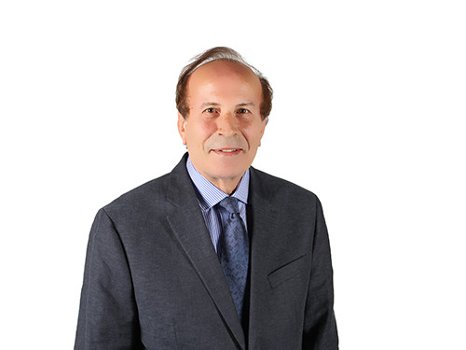
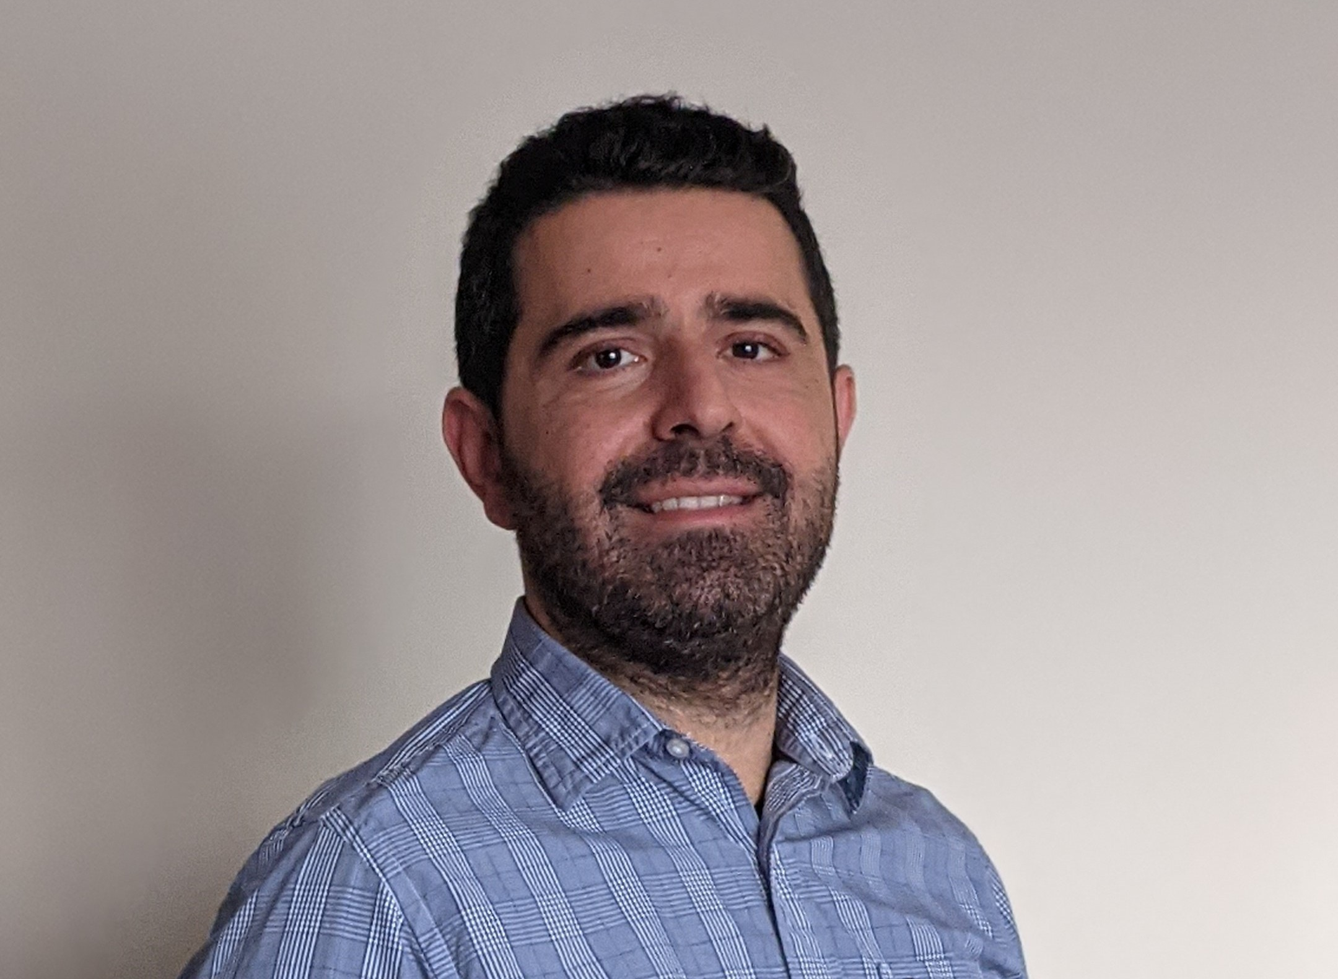
Lütfi Saka
Asst. Prof.
TITLE
PHD
Istanbul University
RESEARCH AREA
Global Business, Strategic Management
E-MAIL
lutfi.saka@okan.edu.tr
PHONE
0 (216) 677 16 30
Business Administration
Onur Emre
Asst. Prof.
TITLLE
PHD
Gebze Technical University
RESEARCH AREA
Human Research Management Organizational Behavior, Management Psychology
E-MAIL
onur.emre@okan.edu.tr
PHONE
0 (216) 677 16 30 / 3068

Slide 6
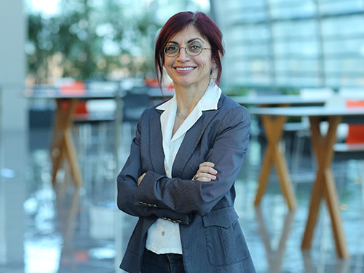
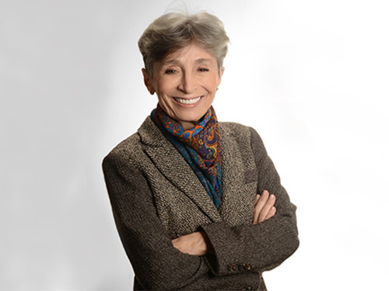
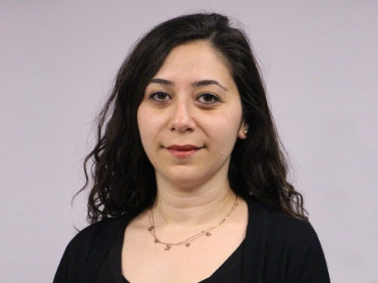
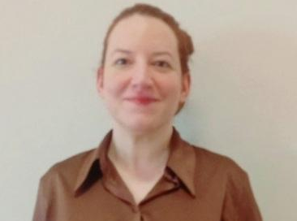
Aylin Soydan
Prof. Dr.
Çiğdem Çelik
Prof. Dr.
TITLE
TITLE
PHD
Middlesex University of London
PHD
Istanbul University
RESEARCH AREA
Economic Policies, Open Macroeconomics, Fiscal Policy
RESEARCH AREA
Energy Economics, Agricultural Economics, Environmental Economics
E-MAIL
aylin.soydan@okan.edu.tr
E-MAIL
cigdem.celik@okan.edu.tr
PHONE
0 (216) 677 16 30 #2514
PHONE
0 (216) 677 16 30 #2501
Economics and Finance
Oya Kent Bırık
Assoc. Prof.
Banu Has
Asst. Prof.
TITLE
TITLE
PHD
Yıldız Technical University
PHD
Ege University
RESEARCH
Regional Economics, Labor Economics
RESEARCH AREA
Econometric Models, Econometrics, Time Series Analysis
E-MAIL
oya.kent@okan.edu.tr
E-MAIL
banu.has@okan.edu.tr
PHONE
0 (216) 677 16 30 #2538
PHONE
0 (216) 677 16 30

Slide 7
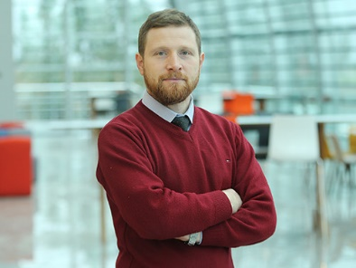
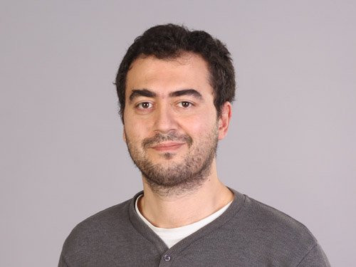
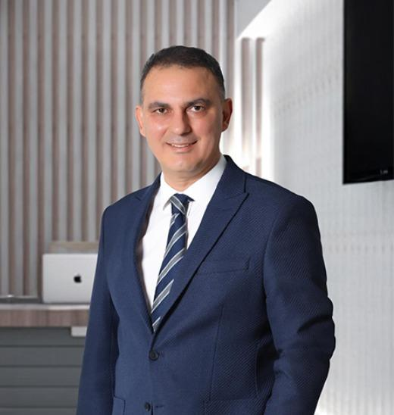
İlker Calayoğlu
Asst. Prof.
Mehmet Gökhan Göktan
Asst. Prof.
TITLE
TITLE
PHD
Sakarya University
PHD
University of Essex
RESEARCH AREA
Financial Information Management, International Accounting, Management and Cost Accounting
RESEARCH AREA
Development Economics, International Finance
E-MAIL
ilker.calayoglu@okan.edu.tr
E-MAIL
mehmet.goktan@okan.edu.tr
PHONE
0 (216) 677 16 30 #2530
PHONE
0 (216) 677 16 30 #2526
Economics and Finance
Mustafa Cenk Uludağ
Asst. Prof.
TITLE
PHD
Istanbul Okan University
RESEARCH AREA
Banking, Financial Markets and Institutions, Corporate Finance
E-MAIL
mustafa.uludag@okan.edu.tr
PHONE
0 (216) 677 16 30

Slide 8
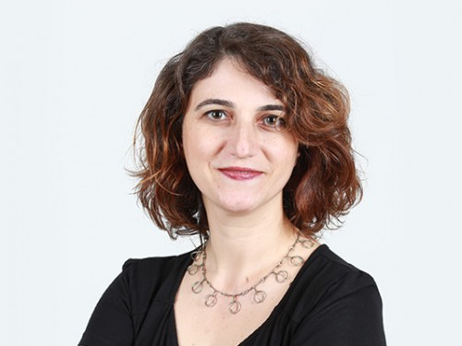
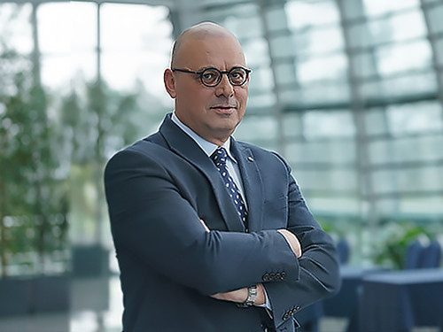
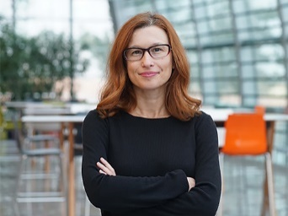
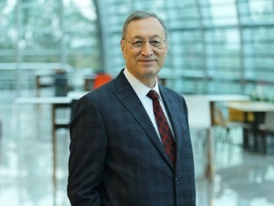
Umut Azak
Ali Poyraz Gürson
Prof. Dr.
TITLE
Prof. Dr.
TITLE
PHD
Universiteit Leiden
PHD
Ege University
RESEARCH AREA
Turkish Political Life, Political Sociology, Constitution and Political Institutions
RESEARCH AREA
Military Geography, Turkish Foreign Policy History, Asian History
E-MAIL
umut.azak@okan.edu.tr
E-MAIL
poyraz.gurson@okan.edu.tr
PHONE
0 (216) 677 16 30 #2531
PHONE
0 (216) 677 16 30 #2500
Political Science and International Relations
Mehmet Kabasakal
Assoc. Prof.
Habibe Özdal
TITLE
TITLE
Asst. Prof.
PHD
Ankara University
PHD
Ankara University
RESEARCH AREA
Turkish Political Life, Constitution and Political Institutions, Comparative Political Movements
RESEARCH AREA
Regional Studies, Turkish Foreign Policy, International Politics
E-MAIL
mehmet.kabasakal@okan.edu.tr
E-MAIL
habibe.ozdal@okan.edu.tr
PHONE
0 (216) 677 16 30 #2045
PHONE
0 (216) 677 16 30 #2532

Slide 9
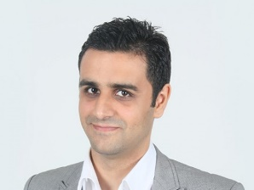
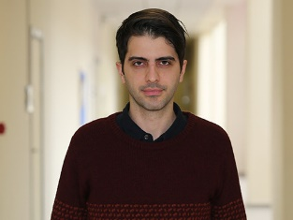
Hasan Deniz Pekşen
TITLE
Asst. Prof.
PHD
Galatasaray University
RESEARCH AREA
International Security, International Politics, International Terrorism
E-MAIL
hasan.peksen@okan.edu.tr
PHONE
0 (216) 677 16 30 #2544
Political Science and International Relations
Gökçe Balaban
TITLE
Asst. Prof.
PHD
Middle East Technical University
RESEARCH AREA
International Security, International Relations Theories, Energy Policies
E-MAIL
gokce.balaban@okan.edu.tr
PHONE
0 (216) 677 16 30 #2475

Slide 10
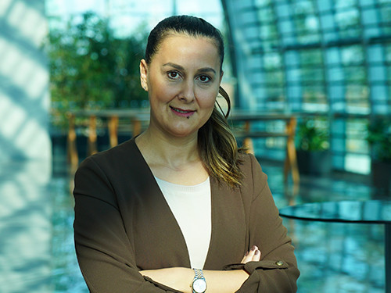
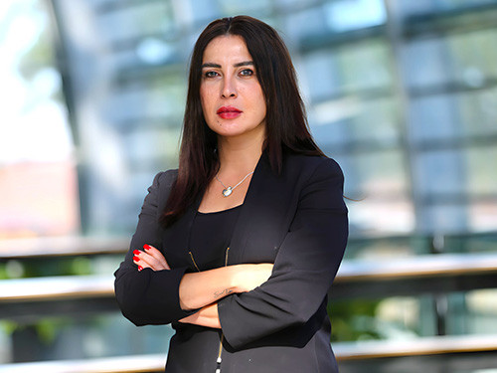
Gökçe Tunç
Prof. Dr.
TITLE
PHD
Izmir University of Economics
RESEARCH AREA
Investments and Portfolio Management, Financial Risk Management, International Finance
E-MAIL
gokce.tunc@okan.edu.tr
PHONE
0 (216) 677 16 30 #2035
Logistics Management
Didem Demir
Assoc. Prof.
TITLE
PHD
Çukurova University
RESEARCH AREA
Digital Marketing, Service Marketing, Consumer Behavior
E-MAIL
didem.demir@okan.edu.tr
PHONE
0 (216) 677 16 30 #0

Slide 11
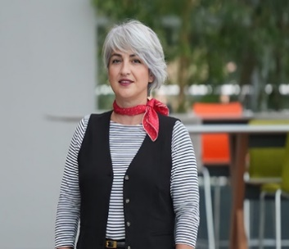
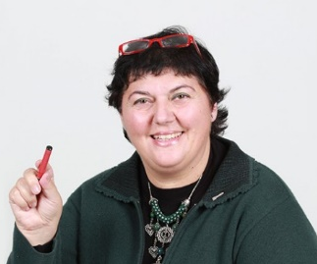
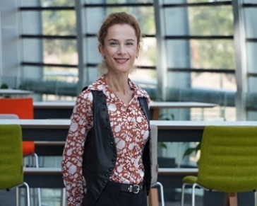
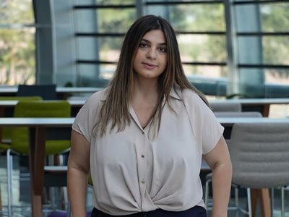
Aynur Pala
Assoc. Prof.
Ayşe Nur Topçuoğlu
Asst. Prof.
TITLE
TITLE
PHD
Marmara University
PHD
Gazi University
RESEARCH AREA
Panel Data Econometrics, Time Series Analysis, Applied Macroeconometrics
RESEARCH AREA
International Trade
E-MAIL
aysenur.topcuoglu@okan.edu.tr
E-MAIL
aynur.pala@okan.edu.tr
PHONE
0 (216) 677 16 30 #2515
PHONE
0 (216) 677 16 30 #2527
International Trade
Esra Ovalı
Asst. Prof.
Gökçen Aydınbaş
Asst. Prof.
TITLE
TITLE
PHD
Yildiz Technical University
PHD
Anadolu University
RESEARCH AREA
International Business Organizations, International Business Management, International Logistics
RESEARCH AREA
Development Economics, Growth, Innovation Economics
E-MAIL
gokcen.aydinbas@okan.edu.tr
E-MAIL
esra.ovali@okan.edu.tr
PHONE
0 (216) 677 16 30
PHONE
0 (216) 677 16 30

Slide 12
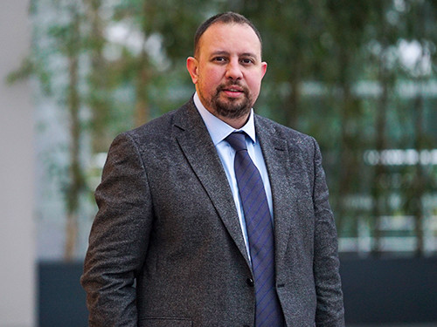
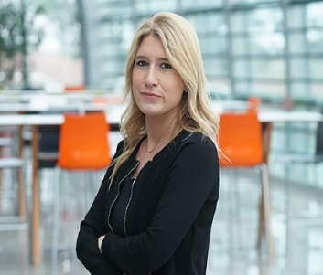
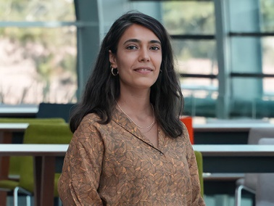
Hazar Dördüncü
Asst. Prof.
İrem Yalkı
Asst. Prof.
TITLE
TITLE
PHD
Istanbul University
PHD
Istanbul University
RESEARCH AREA
International Logistics, Import Export Management
RESEARCH AREA
Growth, Energy Economics, Development Economics
E-MAIL
hazar.dorduncu@okan.edu.tr
E-MAIL
irem.yalki@okan.edu.tr
PHONE
0 (216) 677 16 30
PHONE
0 (216) 677 16 30 #2523
International Trade
Seda Keklik
Asst. Prof.
TITLE
PHD
Marmara University
RESEARCH AREA
International Political Economics
E-MAIL
seda.keklik@okan.edu.tr
PHONE
0 (216) 677 16 30 #2526

Slide 13
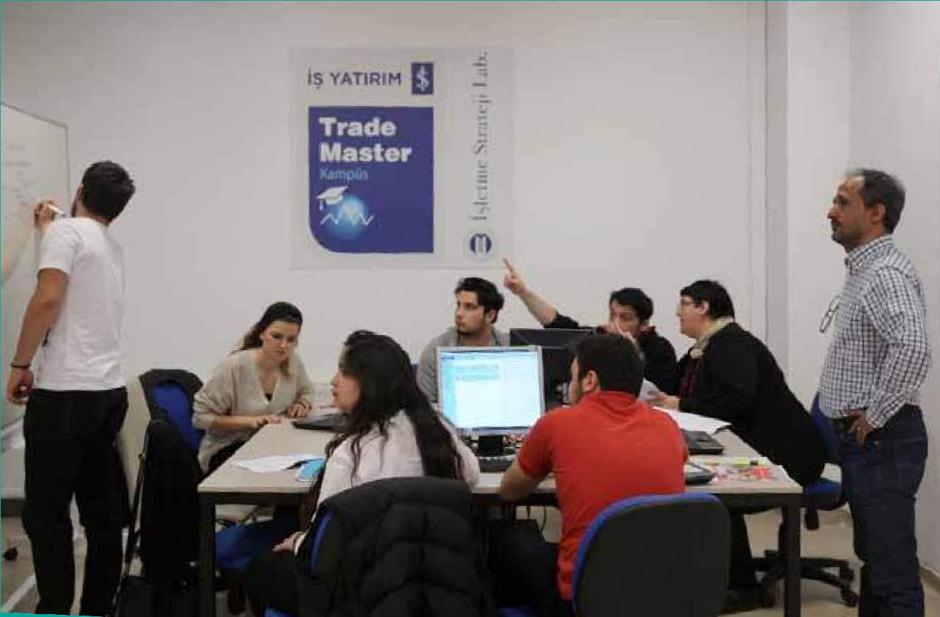
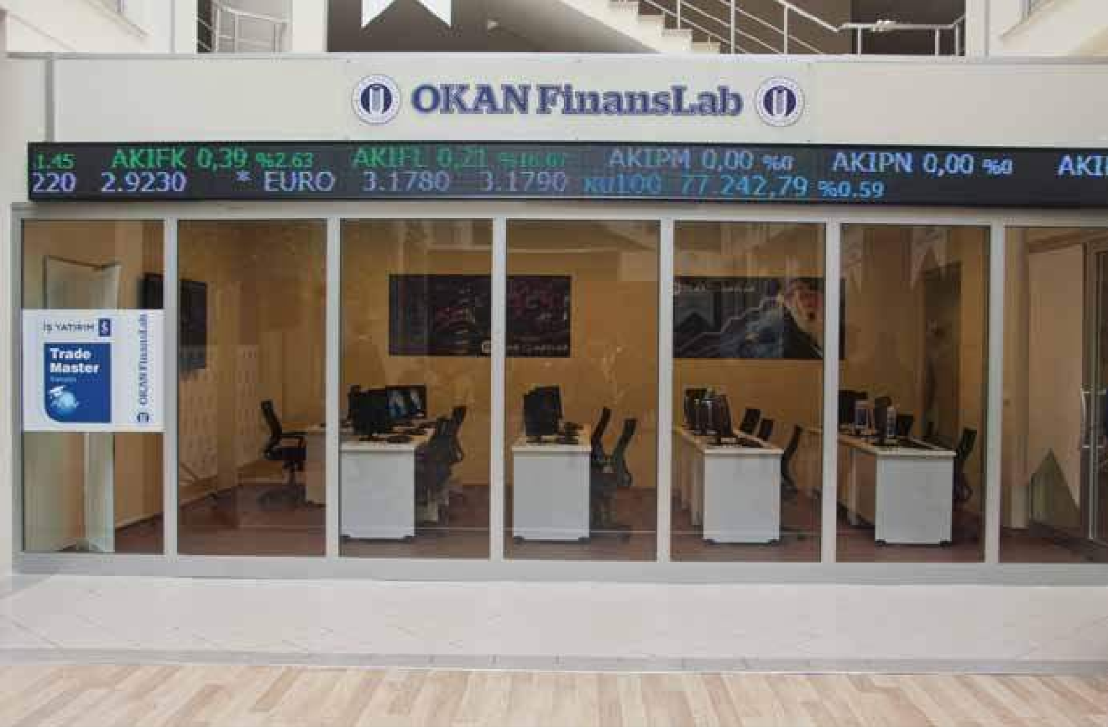
Laboratories and Research Centers
StrategyLab
FinanceLab

